Slide 1

Week 1 – Video 3 Supply and Demand
Professor Nico Voigtländer
Management 405: Module 1

Slide 2
outline of module 1
Basic Principles of Economic Thinking
Economic costs include opportunity costs
Ignore sunk costs
Use cost-benefit and marginal analysis
Economics Fundamentals
Markets
Demand and Supply
Equilibrium

Slide 3
Demand-Supply Analysis
How do supply and demand determine market prices and the quantity produced/consumed?
Wide variety of applications
Example:
How does growth in China affect the price of oil? The price of textiles? The price of (electric) cars?

Slide 4
The market demand curve
Definition: the relationship between the quantity of a good that consumers are willing to buy and the price of the good, holding everything else constant
Notes:
Note: aside from price, we are holding everything else constant, including consumers’ income, tastes, price of other goods.
Thought experiment: suppose you show up at Pike Place Market on a Saturday and observe the price of tomatoes and total quantity that consumers buy. Suppose you can go back in time to that same Saturday and replace all the price tags using an alternative price and see the quantity that consumers buy. Do this over and over until you trace out the demand curve. If tomatoes are $2/pound in one iteration, some people will buy. If they are $1/pound, additional people will buy. As price declines, more consumers want to purchase it. This will make the demand curve downward sloping.
We will get into this in much more detail next week.

Slide 5
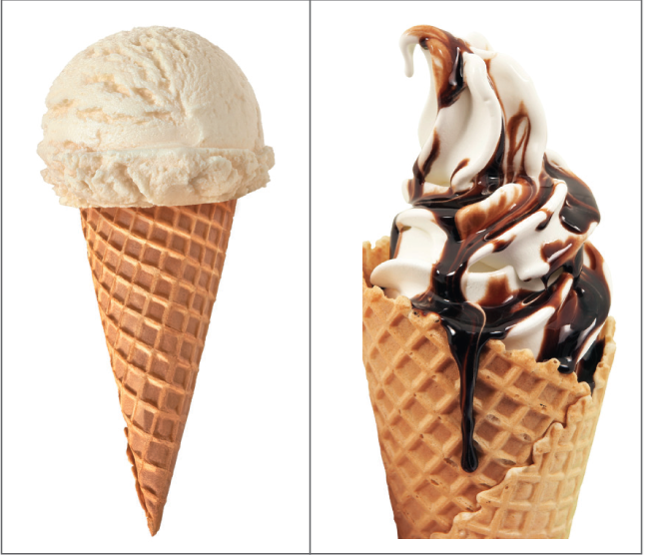
“holding Everything else constant” in econ parlance: “ceteris paribus” (c.p.)
Want to know: how the quantity demanded of an ice cream cone changes with a price increase
Assume: Everything else that affects the quantity demanded remains constant
What is held constant?
Consumer income
Outside temperature
Prices of related goods
Size, shape, quality of the ice cream cone
…everything other than price
Things are not held constant between these two cones
Notes:
Note: aside from price, we are holding everything else constant, including consumers’ income, tastes, price of other goods.
Thought experiment: suppose you show up at Pike Place Market on a Saturday and observe the price of tomatoes and total quantity that consumers buy. Suppose you can go back in time to that same Saturday and replace all the price tags using an alternative price and see the quantity that consumers buy. Do this over and over until you trace out the demand curve. If tomatoes are $2/pound in one iteration, some people will buy. If they are $1/pound, additional people will buy. As price declines, more consumers want to purchase it. This will make the demand curve downward sloping.
We will get into this in much more detail next week.

Slide 6
The market demand curve
Definition: the relationship between the quantity of a good that consumers are willing to buy and the price of the good, holding everything else constant
Price ($)
The demand curve is downward sloping: consumers want to purchase more of a good as its price goes down, all else constant
D
Quantity
Notes:
Note: aside from price, we are holding everything else constant, including consumers’ income, tastes, price of other goods.
Thought experiment: suppose you show up at Pike Place Market on a Saturday and observe the price of tomatoes and total quantity that consumers buy. Suppose you can go back in time to that same Saturday and replace all the price tags using an alternative price and see the quantity that consumers buy. Do this over and over until you trace out the demand curve. If tomatoes are $2/pound in one iteration, some people will buy. If they are $1/pound, additional people will buy. As price declines, more consumers want to purchase it. This will make the demand curve downward sloping.
We will get into this in much more detail next week.

Slide 7
The market demand curve
Distinguish between:
i) Movement along D: changes in quantity demanded when price changes, all else constant
ii) Shift in Demand: changes in demand due to non-price factors
e.g. higher income shifts the demand curve to the right (from D to D′)
Price ($)
P₂
i)
P₁
ii)
D’
D
Q₂
Q₁
Q₃
Quantity

Slide 8

COVID And demand for flour
While in quarantine, many people started to bake. How did the COVID lockdown affect the demand for flour?
“The Coronavirus Baking Boom Has Made It Hard to Find Flour.”
- TIME (May 13, 2020)
In-class discussion

Slide 9
The market supply curve
Definition: Describes the relationship between the quantity of a good that producers are willing to sell and the price of the good, holding everything else constant
Price ($)
S
Upward sloping: the higher the price, the more firms are able and willing to produce and sell, all else constant
Quantity
Notes:
As price rises, quantity supplied will increase. Intuition for upward sloping: many firms experience increasing costs of production as their output rises; need to earn higher price in order to be willing to sell more output. We will get into this in much more detail in Module 4.

Slide 10
The market supply curve
Distinguish between:
i) Movement along S: changes in quantity supplied when price changes, all else constant
ii) Shifts in S: changes in supply; e.g. a shift to the right (from S to S′)
Example: better technology, lower input prices
Price ($)
S
S’
ii)
P₁
i)
P₂
Q₂
Q₁
Q₃
Quantity

